Slide 1


GSORTING
SPRING 2023 CAPSTONE PROJECT
PROF Henry Wong and PROF Emily Tong
CONGYING ZHANG

Slide 2
AGENDA
00
00
Improvements made from Professor Feedback
Problem Statement

Slide 3
AGENDA
01
02
03
04
Project Description
MVP
Technologies
Personas

Slide 4
AGENDA
05
06
07
08
Algorithms
Diagrams
Sprint 1 (CS692) Recap
Product Backlog

Slide 5
AGENDA
09
10
11
12
End
Sprint 2 Backog
Metrics
Retrospective
Project Demo - Sprint 2

Slide 6
00 Improvements made from Professor Feedback
Additional submission of API documentation
Optimization Project
Problem Statement
With this app I want to try to make it easier for users to sort their garbage and create their own garbage type profile.

Slide 7
01 Project Description

Slide 8
Project Description
“Gsorting” is a mobile application developed by Pace University students for CS 691 and CS 692 projects.
Primary goal- Identify waste types and give disposal recommendations
Feature Function- text search and photo scan search.
Better- Intuitive interface and user-friendly design, easier to use! Added trash note function to help users manage trash at home

Slide 9


02
MVP
Gsorting

Slide 10

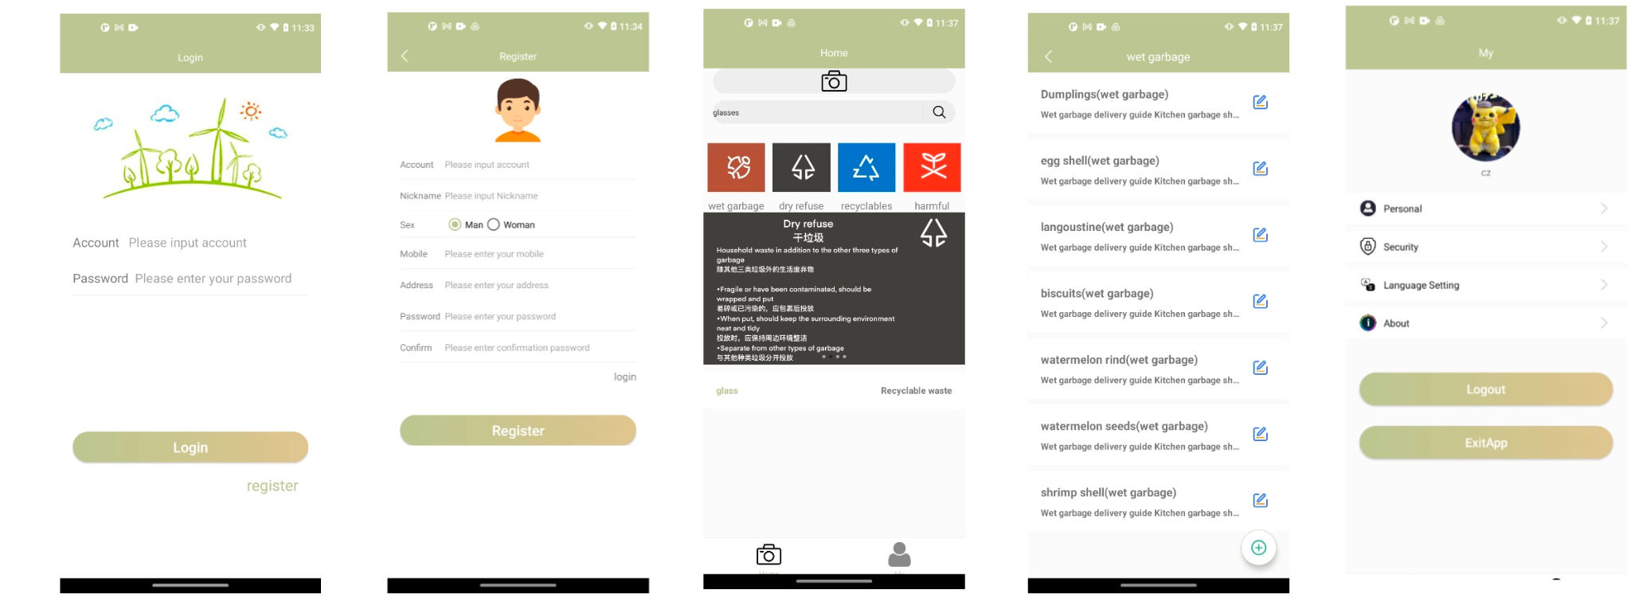
Minimal Viable Product

Slide 11

03
Technologies

Slide 12








Slide 13


04
Personas

Slide 14

Persona 1-Eco-Conscious Edith Name: Edith Lucy Age: 30
Environmentally conscious homeowner: This person is environmentally conscious and actively seeks ways to reduce their household's carbon footprint. They may use the Gsorting app to identify and dispose of household waste in an environmentally friendly way.

Slide 15
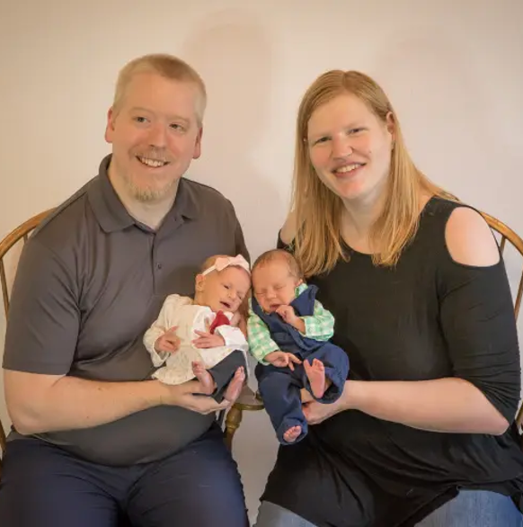
Persona 2 - Busy White Name: Mr. White & Mrs. White Age: 33 & 28 (Mr. White & Mrs. White)
Busy Parents: This persona is a pair of busy parents with limited time to do household chores. They can use the Gsorting app to identify the type of waste and get quick disposal advice to get rid of household waste quickly.

Slide 16
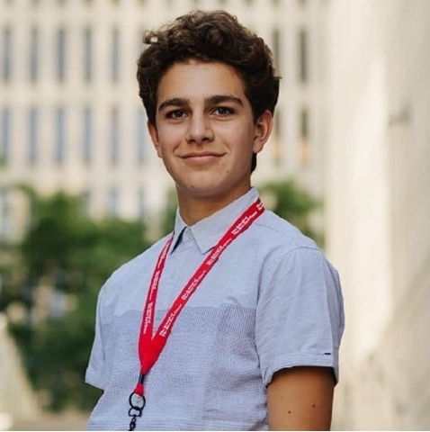
Persona 3-Student Sam Name: Sam Peter Age: 20
Student tenant: He's a college freshman. He may not be familiar with the waste management regulations of the city where the university is located and he can use the Gsorting app to properly sort his household waste and avoid fines.

Slide 17
05
Algorithms

Slide 18
Deep learning model
A garbage classification dataset is first collected, including various types of garbage images.
The ResNet18 model was selected as the classifier. The accuracy of the garbage classification task using the ResNet18 model was tested to be relatively high, typically above 97%.

Slide 19
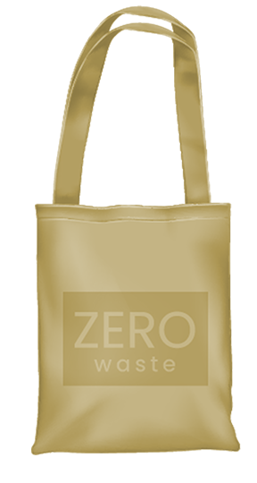
06
Architecture Diagrams

Slide 20
Architecture Diagrams
01
Conceptual Diagram
03
Class Diagram
02
Sequence Diagram
04
Use Case Diagram

Slide 21
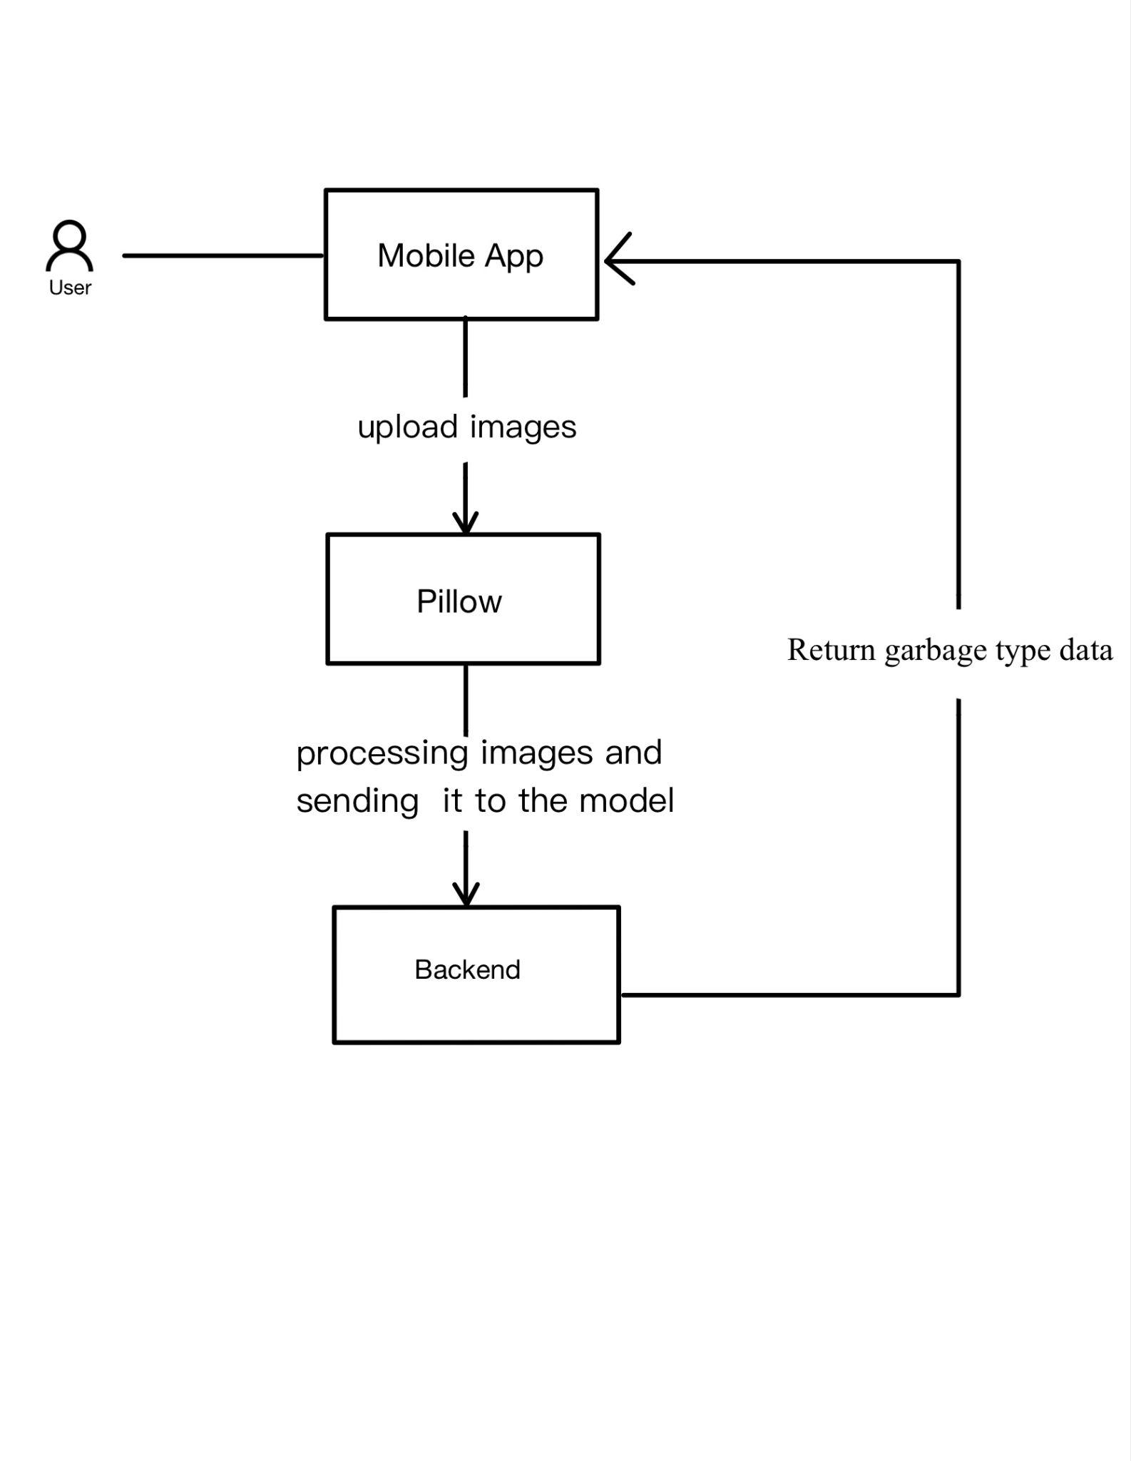
Conceptual Diagram

Slide 22
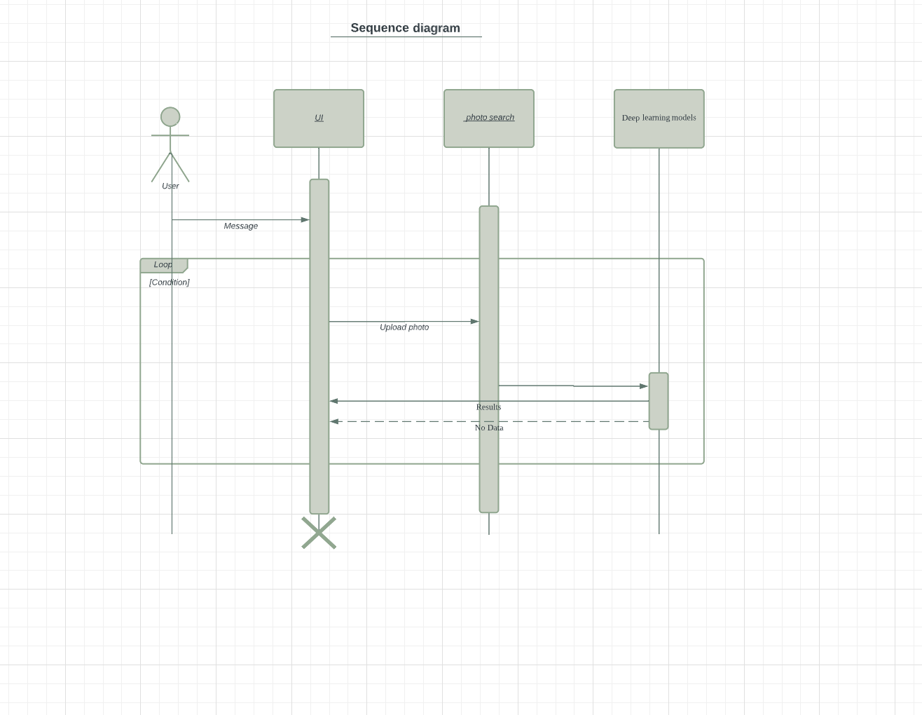
Sequence Diagram

Slide 23
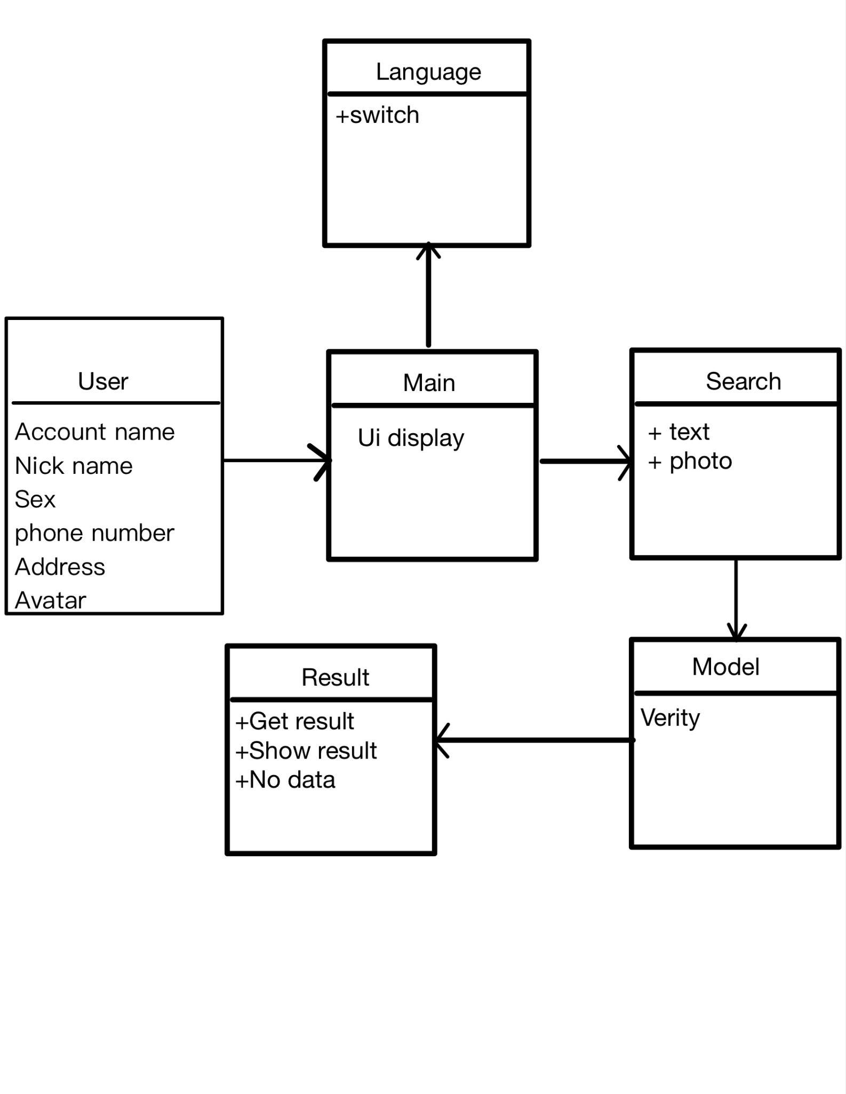
Class Diagram

Slide 24
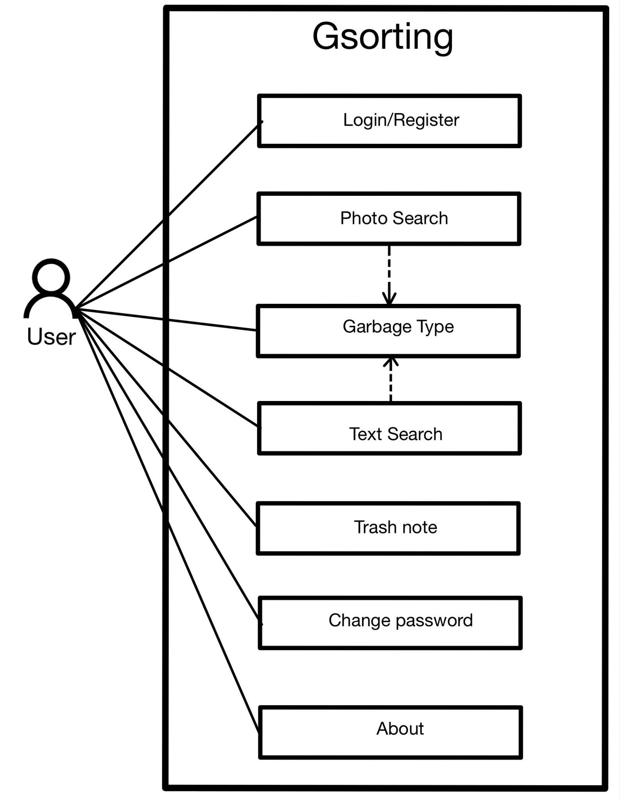
Use Case Diagram

Slide 25
07
Sprint 1 Recap

Slide 26
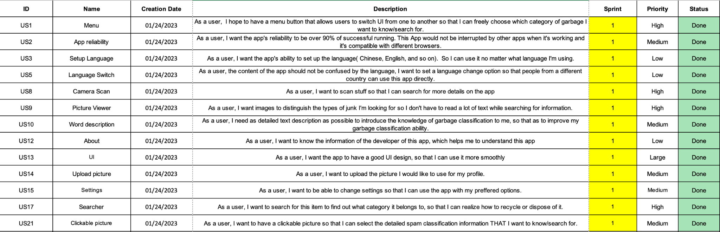

Slide 27

08
Product Backlog

Slide 28
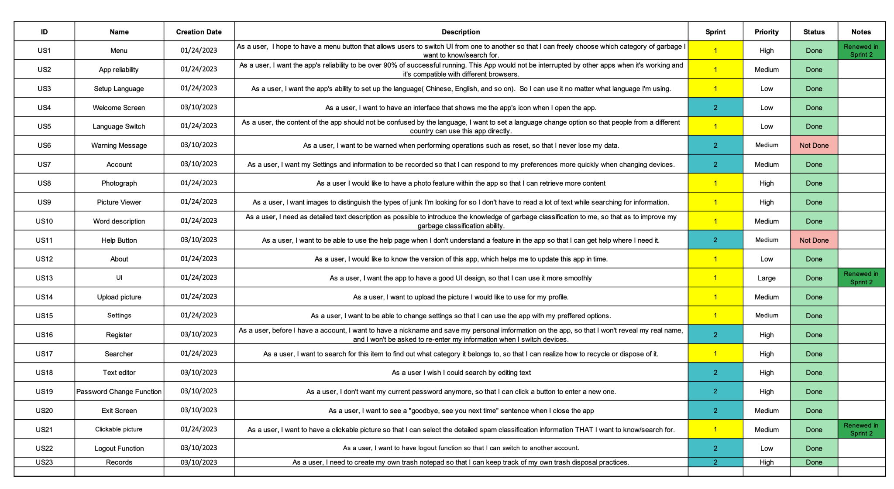

Slide 29
09
Sprint 2 Backlog

Slide 30
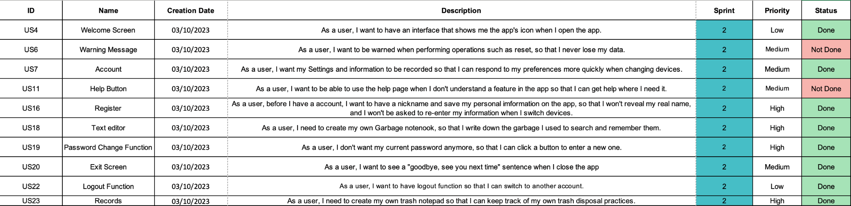

Slide 31
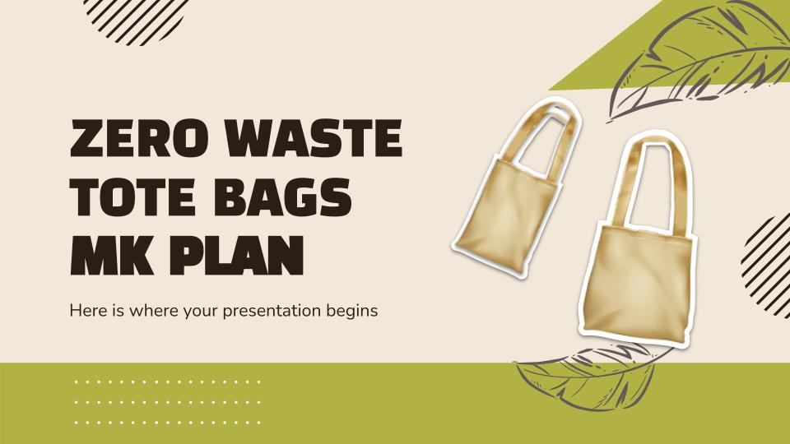
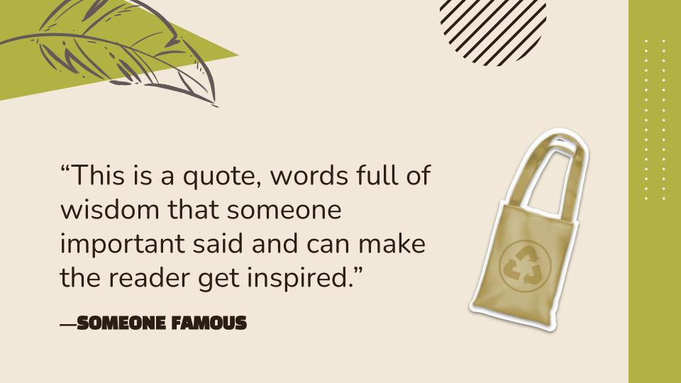
10
Metrics

Slide 32
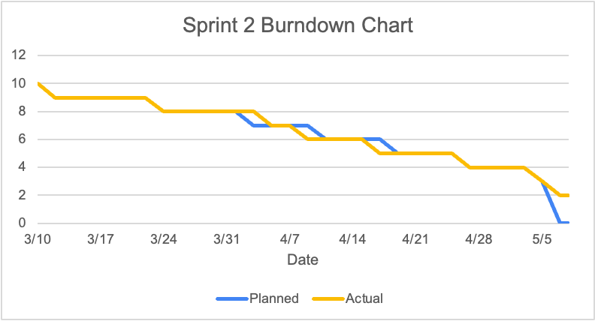
Team velocity and Burndown Charts
Sprint 2, I completed user stories

Slide 33
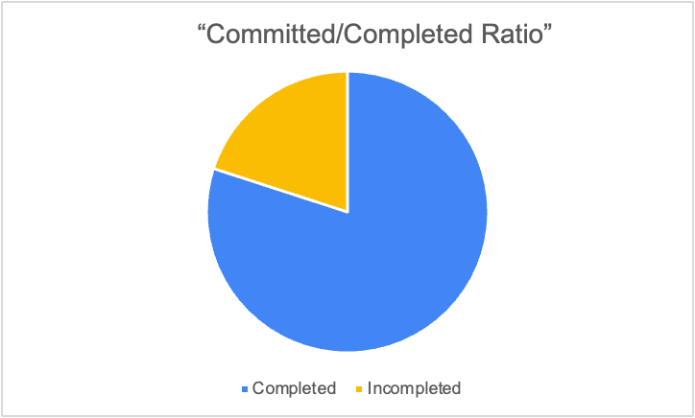
Completed/Committed Ratio
=8/10
=80%

Slide 34
11 Retrospective
Not good？
Better？
Next？
Improve？

Slide 35
Retrospective
What is going well？
01
What needs to be improved？
UI design is easy to use
Completed deep learning model as back-end
02
Larger images can't be uploaded, I need to try to fix this
What to do next？
03
Access to AWS for the app

Slide 36
12
GitHub
https://github.com/htmw/2023S-czhang

Slide 37
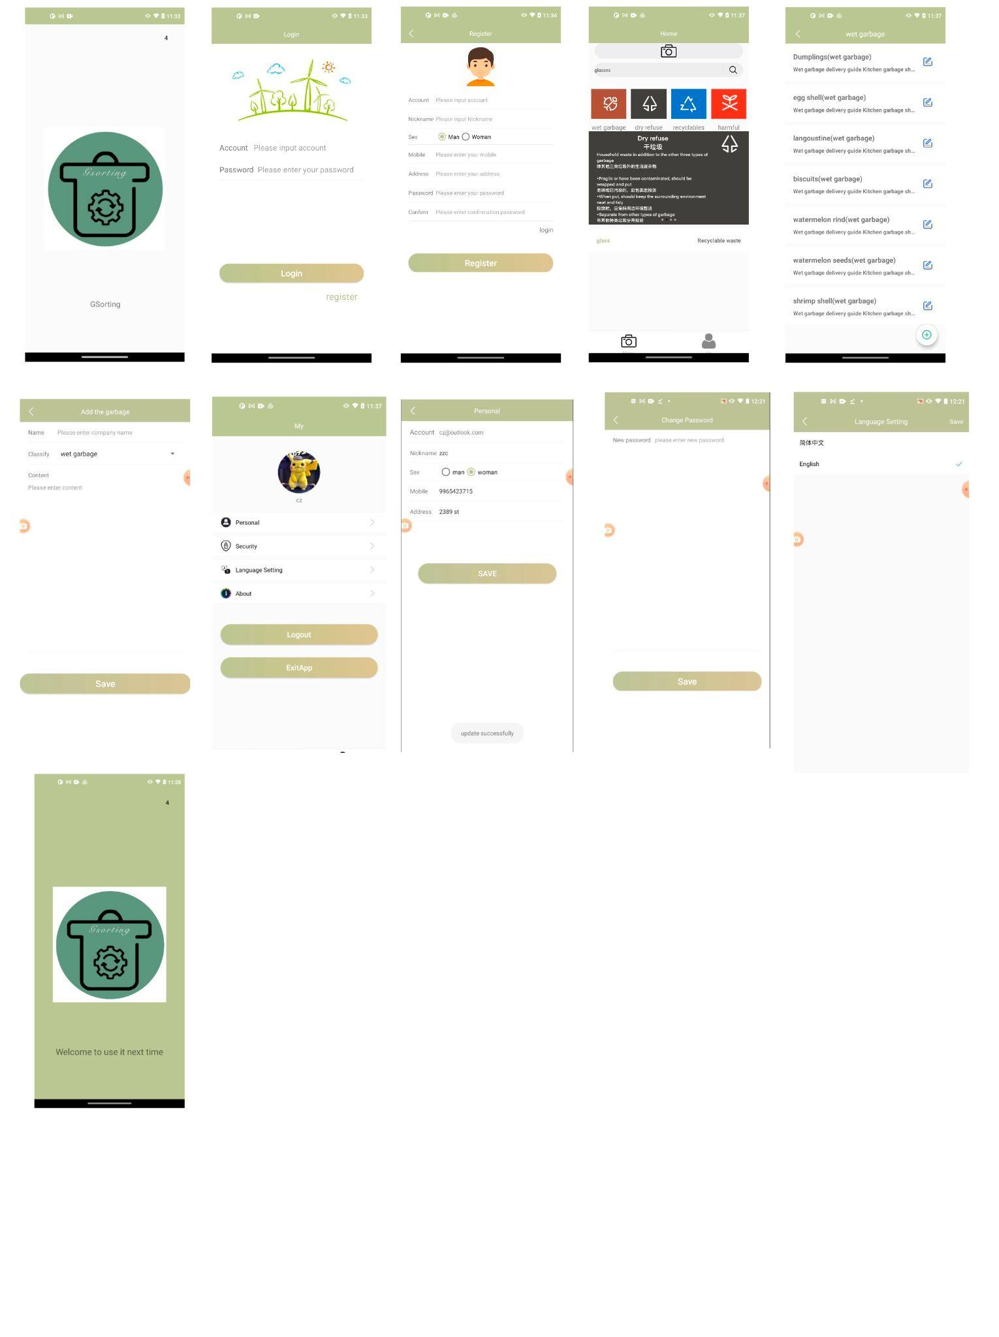
12. MVP Project Demo

Slide 38
12. MVP Project Demo

Slide 39
12. MVP Project Demo

Slide 40
Live Application Demo: https://www.youtube.com/watch?v=1pFVk-YiBwQ
Thanks

